Slide 1
Capstone Project - Car accident severity
- Anuj Litoriya

Slide 2
Introduction
Street traffic accidents are presently assessed to be the eighth driving reason for death over all age bunches internationally, and are anticipated to turn into the seventh driving reason for death by 2030. Investigating a critical scope of elements, including weather conditions, extraordinary occasions, road works, gridlocks among others, an exact forecast of the severity of the accidents can be performed.

Slide 3
Death Caused by traffic accidents:
-1.35 million people die each year as a result of road traffic crashes
-Government ought to be exceptionally intrigued by precise predictions of the severity of a mishap, so as to decrease the hour of appearance and in this manner spare a lot of individuals every year.

Slide 4
Data Section
Data source
Data has been imported from following page of kaggle https://www.kaggle.com/ahmedlahlou/accidents-in-france-from-2005-to-2016
Feature Selection
The information comprising of the apparent multitude of recorded accidents in France from 2005 to 2016. The qualities informational index contains data on the time, spot, and sort of crash, weather and lighting conditions furthermore, sort of convergence where it happened. The spots informational index has the street specifics, for example, the inclination, shape and class of the street, the traffic system, surface conditions and foundation. On the client informational index it very well may be discovered the spot involved by the clients of the vehicle, data on the clients associated with the reason of voyaging, severity of the utilization of security gear furthermore, data on the people on foot.

Slide 5
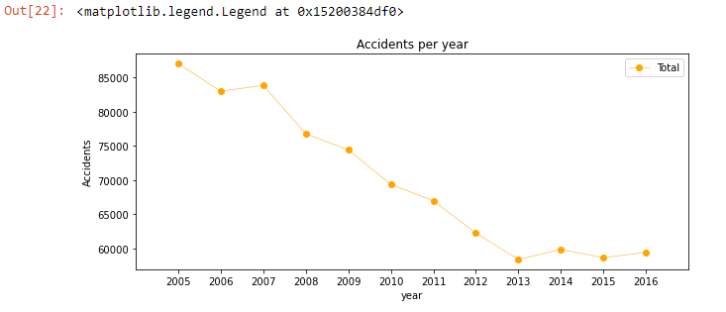
Exploratory Data Analysis(EDA)
Traffic accidents decrease from year 2005 to 2013

Slide 6
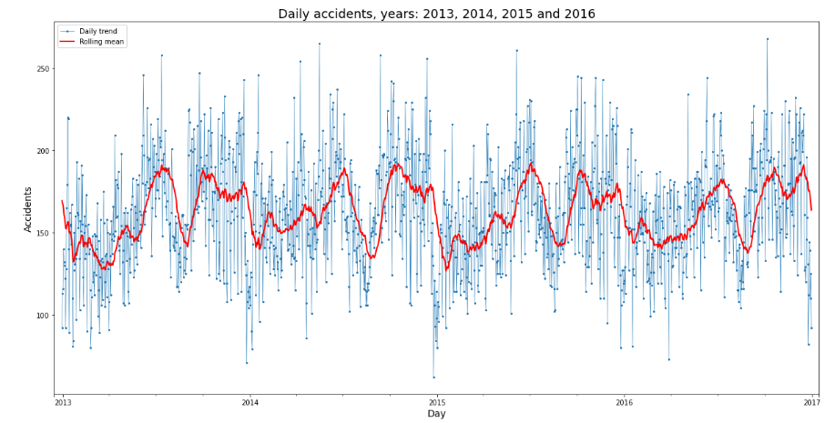
Exploratory Data Analysis(EDA)
Line plot- accident per day during the 2013, 2014, 2015 and 2016. includes the rolling mean, window size 30 days

Slide 7
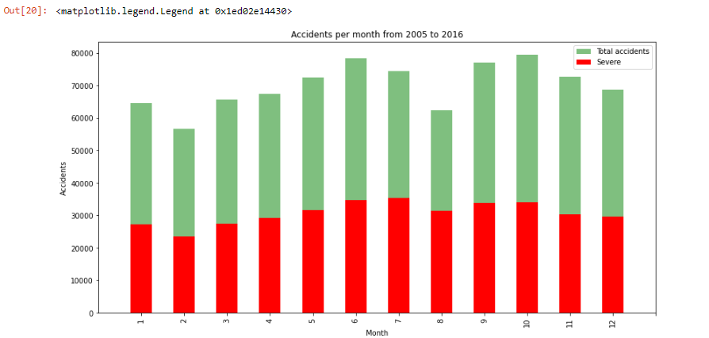
Exploratory Data Analysis(EDA)
Accidents increase from March to June

Slide 8
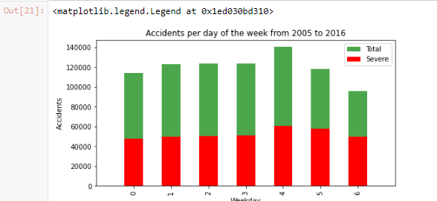
Exploratory Data Analysis(EDA)
More accidents on Friday and less on Sunday

Slide 9


Models
Decision Tree:
Random Forest

Slide 10
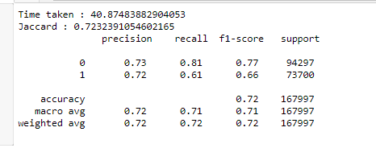
Confusion Matrix
Random Forest

Slide 11
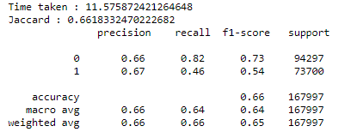
Confusion Matrix
Logistic Regression

Slide 12
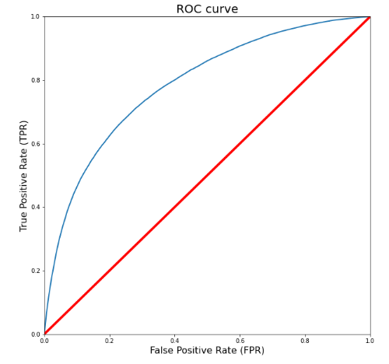
Result
According to the accuracy , precision and Recall , Random Forest is the best suited Model for this particular classification.
It actually improved accuracy from 63% to 72%.

